Slide 1
CSE302_Software Quality Engineering
Chapter 1
What is Software Quality?
Instructor: Sobia Usman
Assistant Professor
CS - CUI, LHR

Slide 2
What is software?
Usually referred to as the “code”.
Is it enough to take care of the code in order to assure the quality of the services provided by the software program?
Are additional elements necessary to assure their quality and assure the operational success of the software system?

Slide 3
Software –IEEE definition
Software is:
Computer programs, Procedure, and possibly associated documentation and data pertaining to the operation of a computer system.

Slide 4
Software Components
According to IEEE definition of software
Computer Programs(the “code”)
desired features
functions and
performance.
They activate the computer to perform the required applications.
Procedures
Are required to define
The Order and schedule in which the programs are performed
The method employed
Notes:
All four components are needed to assure the quality of the software development process and maintenance services

Slide 5
Software Components
The data
on which the program operates
Standard Test Data
Documents
The development documentation (the requirements report, design reports, program descriptions, etc.)
The user’s documentation (the “user’s manual”, etc.)
The maintenance documentation(the “programmer’s software manual”, etc.)
To sum up, software quality assurance always includes, in addition to code quality, the quality of the procedures, the documentation and the necessary software data.
Notes:
All four components are needed to assure the quality of the software development process and maintenance services

Slide 6
Software Errors, Faults and Failures
Software Errors:
Sections of the code that are partially or totally incorrect as a result of a grammatical, logical or other mistake made by a systems analyst, a programmer, or another member of the software development team.
Software Faults
are software errors that cause the incorrect functioning of the software in general or in specific application.
Software faults become software failures only when they are “activated”, that is, when a user tries to apply the specific software section that is faulty. Thus, the root of any software failure is a Software error.
Do all software faults end with software failures?

Slide 7
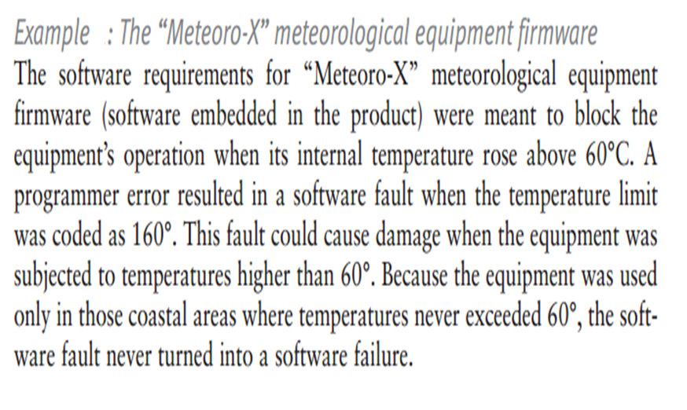
Software Errors, Faults and Failures

Slide 8
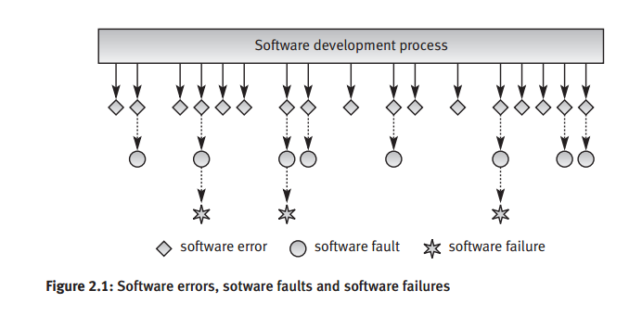
Relationships between Software errors, faults and failures

Slide 9
Classification of Causes of Software Errors
As software errors are the cause of poor software quality, it is important to investigate the causes of these errors in order to prevent them.
The causes of software errors can be further classified as follows according to the stages of the software development process in which they occur.
Faulty definition of requirements
Erroneous definition of requirements
Absence of vital requirement
Incomplete definition of Requirement
Inclusion of unnecessary requirements

Slide 10
Classification of Causes of Software Errors
Client–developer communication failures
Misunderstanding of the
Client’s instructions as stated in the requirement document
Client’s requirements changes presented to the developer
Client’s responses to the design problems presented by the developer.
Lack of attention to client messages referring to requirements changes
Deviations from software requirements
The developer reuses software modules taken from an earlier project without sufficient analysis of the changes
Due to time or budget pressures, the developer decides to omit part of the required functions
Developers may deliberately deviate from the documented requirements

Slide 11
Classification of Causes of Software Errors
Logical design errors
Algorithm mistakes
Erroneous definition of boundary conditions.
For example, the client’s requirements stated that a special discount will be granted to customers who make purchases more than three times in the same month. The analyst erroneously defined the software process to state that the discount would be granted to those who make purchases three times or more in the same month.
Omission of required software system states.
Omission of definitions concerning reactions to illegal operation of the software system.

Slide 12
Classification of Causes of Software Errors
Process definitions that contain sequencing errors.
For example, the software requirements for a firm’s debt-collection system define the debt-collection process as follows.
Once a client does not pay his debts, even after receiving three successive notification letters, the details are to be reported to the sales department manager who will decide whether to proceed to the next stage, referral of the client to the legal department. The systems analyst defined the process incorrectly by stating that after sending three successive letters followed by no receipt of payment, the firm would include the name of the client on a list of clients to be handled by the legal department. The logical error was caused by the analyst’s erroneous omission of the sales department phase within the debt-collection process.

Slide 13
Classification of Causes of Software Errors
Coding errors
It include misunderstanding the design documentation, linguistic errors in the programming languages, errors in the application of CASE and other development tools, errors in data selection.

Slide 14
Classification of Causes of Software Errors
Non-compliance with documentation and coding instructions
Team members who need to coordinate their own codes with code modules developed by “non-complying” team members can be expected to encounter more than the usual number of difficulties when trying to understand the software developed by the other team members.
Individuals replacing the “non-complying” team member (who has retired or been promoted) will find it difficult to fully understand his or her work.
The design review team will find it more difficult to review a design prepared by a non-complying team.
The test team will find it more difficult to test the module; consequently, their efficiency is expected to be lower, leaving more errors undetected.
Maintenance teams required to contend with the “bugs” detected by users and to change or add to the existing software will face difficulties when trying to understand the software and its documentation.

Slide 15
Classification of Causes of Software Errors
Shortcomings of testing process
Incomplete test plans leave untreated portions of the software
Incomplete correction of detected errors due to negligence or time pressures.
Documentation Errors
Omission of software functions.
Errors in the explanations and instructions given to users, resulting in “dead ends” or incorrect applications.
Listing of non-existing software functions, that is, functions planned in the early stages of development but later dropped, and functions that were active in previous versions of the software but cancelled in the current version.

